Slide 1
Tutorial 5

Slide 2
Question 1: Given F(A,B,C,D) = ∑m(0,4,5,10,11,13,14,15).
(a) Find two different minimum circuits which implement F using AND and OR
gates and identify the hazards in each.
(b) Find an AND-OR circuit for F which has no hazards.
(c) Find an OR-AND circuit for F which has no hazards.
Question 2: A logic function f(A,B,C,D) is defined by the following input-output relationship.
A) Implement the function W
using ONE 4-to-1 multiplexer
and other logic gates.
B) Implement the function X
using ONE 4-to-1 multiplexer
and other logic gates.
Inputs |  |  |  | Outputs
A | B | C | D | W | X | Y | Z
0 | 0 | 0 | 0 | 0 | 1 | 1 | 1
0 | 0 | 0 | 1 | 1 | 0 | 0 | 0
0 | 0 | 1 | 0 | 1 | 0 | 0 | 1
0 | 0 | 1 | 1 | 1 | 1 | 0 | 0
0 | 1 | 0 | 0 | 1 | 1 | 1 | 0
0 | 1 | 0 | 1 | 1 | 0 | 1 | 0
0 | 1 | 1 | 0 | 1 | 1 | 0 | 1
0 | 1 | 1 | 1 | 1 | 1 | 1 | 1
1 | 0 | 0 | 0 | 1 | 0 | 1 | 1
1 | 0 | 0 | 1 | 0 | 1 | 0 | 1

Slide 3
Question 3: Implement the function
f(x,y,z) = ∑m(0,3,5,7) using a
a) 8-to-1 multiplexer
b) 4-to-1 multiplexer
Question 4: Implement the following expression using a demultiplexer.
F(X,Y,Z) = ∑ m(2,4,6,7)
Question 5: Implement the following function by a single 4:1 Multiplexer and draw the circuit.
F (A, B, C, D) = Σ(0,1,4,5,8,11,12,15)

Slide 4
Question 6: For the two-level AND-OR implementation of F = AB’ + BC, suppose the gate delays for NOT, AND and OR gates are 10ns, 15ns and 20ns, respectively.
If A = B = C = 1 initially and then B changes to 0 at t = 10ns, plot the outputs D, E and F together with B on a timing diagram, showing clearly the times at which the outputs change state.

Slide 5
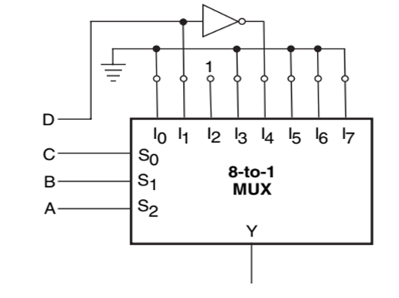
Question 7: Implement the following function by a single 4:1 Multiplexer and draw the circuit.
F (A, B, C, D) = Σ(1,3,4,11,12,13,14,15) .
Question 8: The use of an 8-to-1 multiplexer to implement a certain four-variable Boolean function Y(A,B,C,D). From the given logic circuit arrangement, derive the Boolean expression implemented by the circuit.

